Slide 1
Evaluating Key Performance Indicators and Sales Dynamics
Data-Driven Storytelling

Slide 2
Problem statement
The company intends to analyse account performance metrics during the last five years (2017-2021) and the elements that contribute to its compound annual growth rate (CAGR) IN UNIT SALES.
This includes identifying opportunities for future improvement.

Slide 3
Queries raised
To analyse year-over-year sales.
To examine the total unit sales for each year.
To calculate the average 5 year compound annual growth rate (CAGR).
To evaluate the top performing and bottom performing accounts.
To examine total unit sales for each year.

Slide 4
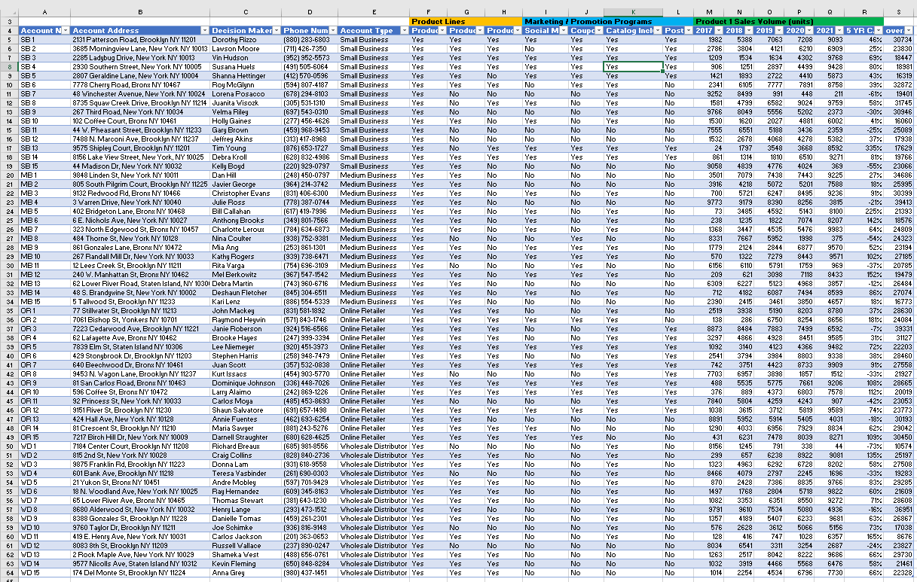
Data modelling

Slide 5
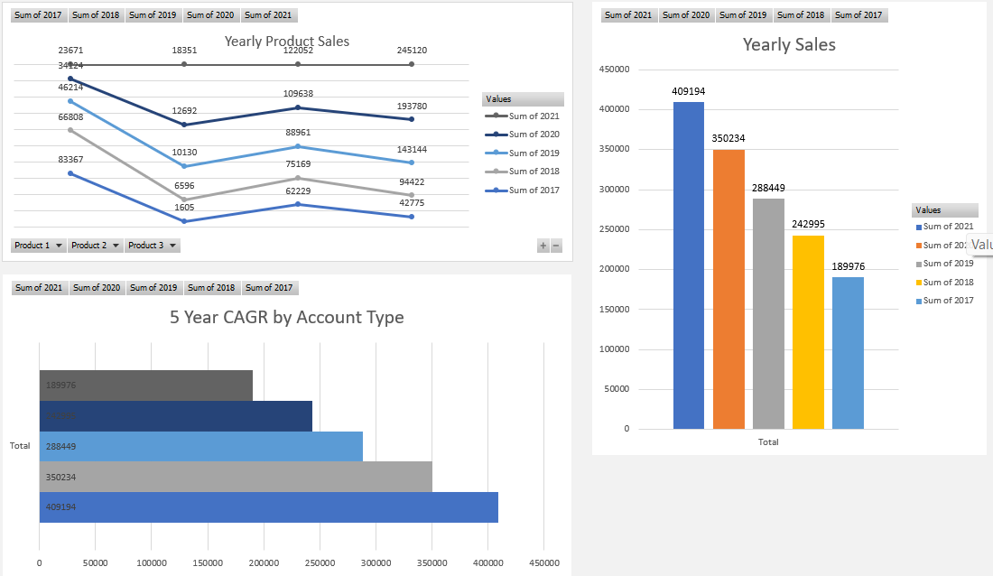
Data visualization

